Slide 1
Machine Learning With Python
Kaijie Zhang

Slide 2
What is machine learning?
Used by several big companies in the tech industry: Google, Amazon, Microsoft, Tesla, etc.
Chatbots, image recognition, targeted ads
“Building a model from example inputs to make data driven predictions versus strictly following program instructions”
Notes:
We hear machine learning a lot these days in the tech industry, and companies will try to throw the word in every now and then to try to perk some ears. But we have to make sure we understand what it really is, so we don’t just throw it around like a buzzword.
Examples of machine learning include chatbots, voice recognition systems (such as Siri and Cortana), and those annoying targeted ads you see everyday, which are recreated from previous search history, and visited content. We can see that it’s powerful for the everyday tools and platforms we use, but the future of machine learning and artificial intelligence might actually get to the point of what we see in TV shows and movies, such as robot companions, or technology that can read your mind.
That’s wonderful and all, but for the scope of this presentation, I will be limiting it to definition of machine learning as “building a model from example inputs to make data driven predictions versus strictly following program instructions”. Doesn’t sound as sexy as self driving cars now, is it? That’s because the majority of backend machine learning algorithms are just functions and models that are defined through data, but the output can be utilized by the frontend to project it in an impressive manner for the user. Nonetheless, the algorithms can get quite complex, and getting a very good model can often times be challenging. But we’ll take a look at a simple case to get a handle on how machine learning actually works.

Slide 3
Types of Machine Learning
Supervised | Unsupervised
Classification: output is a category i.e. True, False, Disease, Non-disease | Clustering: discovering inherent groupings in data, such as grouping customers by purchasing behaviour
Regression: output is real value i.e. price, weight, height | Association: discovering rules that describe large portions of your data, such as if X occurs, then Y will most likely occur

Slide 4
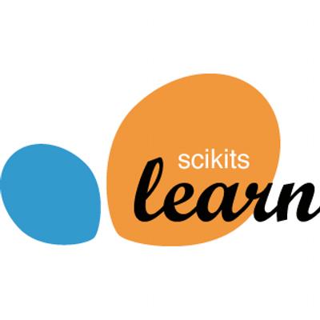




Python and Jupyter Notebook
Python 3: comes with standard libraries that include machine learning capabilities
Numpy, Pandas, Matplotlib, Scikit-learn
IDE: Jupyter Notebook
https://github.com/jupyter/jupyter/wiki/Jupyter-kernels
Notes:
Numpy: supports scientific computing through n dimensional arrays, and linear algebra
Pandas: data frames that make it easy to access and analyze data
Matplotlib: 2D plotting library
Scikit-learn: tools for performing machine learning operations
Jupyter notebook: good for iterative trial and error and record keeping. Documents produced are presentation quality, and easily shared as a “notebook”. Supports more than just Python

Slide 5
Machine Learning Workflow
Asking the right question
Preparing the data
Selecting the algorithm
Training the model
Testing the model

Slide 6
Asking The Right Question
“Use the Machine Learning Workflow to process and transform Pima Indian data to create a prediction model. This model must predict which people are likely to develop diabetes with 70% or greater accuracy.”
“Using Pima Indian Diabetes data, predict with 70% or greater accuracy, which people will develop diabetes.”
“Using Pima Indian Diabetes data, predict which people will develop diabetes.”
“Using Pima Indian Diabetes data, predict with 70% or greater accuracy, which people are likely to develop diabetes.”
“Predict if a person will develop diabetes.”
Define 4 items within the question:
→ scope
→ target performance
→ context for usage
→ how solution will be created
Notes:
At first, asking the right question seems easy: “Predict if a person will develop diabetes”. Nice, fast, simple, done, let’s get the data now.
Need question that will direct and validate work: will point the direction of the gather that we gather, mold and shape the data, how we interpret the solution, and the criteria we use to validate the solution. One liner will not cut it.
Define scope, define target performance, define context for usage, define how solution will be created
Identify critical factors. Focus on higher diabetes risk racial groups.
Pima Indian Diabetes study → study conducted in the 90’s on women of the Pima Indian population in the Southern Arizona area. Available at UCI machine learning repository.

Slide 7
Preparing The Data
Sources: Google, government databases, professional or company data sources, your own company
UCI Machine Learning Repository → Pima Indian Data
All female patients, at least 21 years old
768 observation rows, 9 feature columns, and 1 class column
Tidy datasets → easy to manipulate, each variable is a column, each observation is a row, and
Notes:
Be careful of controversial topics like global warming. Data may be manipulated or skewed
Your own company’s data from the IT department
Data rule #1: The closer the data is to what you are predicting, the better. Sometimes data won’t be as nice as this one, where the class column is exactly what we want. So there would be need for interpret the outcome from multiple columns
Data rule #2: Data will never be in the format you need. In Python, use Pandas Dataframes to reformat the data
50-80% of the time in a machine learning project is spent preparing the data

Slide 8
Diabetes Study Demo

Slide 9




Role of the Algorithm
Training Data
Algorithm
fit()
Real Data
Model
Results
predict()
Notes:
Next, take a look at what algorithms are suitable for our analysis
We will choose an algorithm to be our "initial" algorithm, as it is very likely that testing said algorithm can lead to non-accurate results
The algorithm is the engine that drives the process
When Fit(), the training function in Scikit-learn, is called, it will take the algorithm and use it to process the training data, essentially analyzing it
This analysis evaluates the data with respect to a mathematical model and logic associated with the algorithm
Algorithm uses results of analysis to adjust internal parameters to produce a model that has been trained to best fit the features of the training data, and produce the associated class result.
So now the parameters are taken and stored, and the model is said to be trained. Later on, the predict() function is used, and then it will take real data, and classify them

Slide 10
Selecting Our Initial Algorithm
Decision factors: Learning type, Result, Complexity, Basic vs. Enhanced
“Use the Machine Learning Workflow to process and transform Pima Indian data to create a prediction model. This model must predict which people are likely to develop diabetes with 70% or greater accuracy.”
Supervised, classification, binary, non-ensemble
Naïve Bayes
Notes:
Since machine learning can be applied to a lot of problems, there are a lot of machine learning algorithms available. A quick check of the scikit-learn library shows that there are over 50, and more being created. So how do we decide which algorithm to use? To decide which algorithms would be suitable, we can compare the algorithms on a number of factors. Not surprisingly, data scientists have different opinions on what factors are important in selecting algorithms. The decision factors presented here represent one possible set of factors. As you gain experience, you will likely develop your own set of factors and decision criteria. For our example, we are going to use these decision factors to select our initial algorithm: what learning type they support, the result type the algorithm predicts, the complexity of the algorithm, and whether the algorithm is basic or enhanced. We will use our solution statement and knowledge of the workflow to help guide us in the evaluation of these factors. Each algorithm has a set of problems with which it works best. One way to divide them is to look at the type of learning they support.
With that in mind, let's go back to the solution statement and see what guidance it offers. Reading the statement, we see that our solution is about prediction. Prediction means supervised machine learning, so we can eliminate all algorithms that do not support supervised machine learning. That reduces the number of choices, but we still have a lot. Let's see what else we can do. Let's see how the result type can help. Prediction results can be divided into two categories, regression and classification. Regression means a continuous set of values. Back in our example of determining the price of the house, we used the features of the house, size, number of bedrooms, et cetera. We put these features into an equation and produced a price. Any change in any feature resulted in a direct change in the price. In contrast, classification problems have a discrete set of values, such as: small, medium, or large; one to 100, 101 to 200, 201 to 300; or true and false. Changes in the feature values may or may not change the classification. So what type of problem do we have? Again, the solution statement comes to our aid. From the solution statement, we see that the algorithm must predict which people are likely to develop diabetes. Remember, diabetes is true or false, and therefore diabetes is a binary outcome. Since we are predicting a binary outcome, diabetes or not, we can eliminate any algorithms that do not support classification in general and binary classification in particular. That disqualified some more algorithms, but perhaps not as many as you might have thought. This is because many algorithms support both regression and classification.
We are down to 20 algorithms, but that is still too many. Since this is our initial algorithm, let's keep it simple. Let's also eliminate algorithms that are ensemble algorithms. These are special algorithms that combine multiple algorithms under one interface. These algorithms are more often used when we need to tune a model to increase performance. And we are still trying to do our initial training. Also, ensemble algorithms tend to be complex and difficult to diagnose and troubleshoot when the results start going awry. We still have a field of algorithms left, and we can divide these into two groups, basic and enhanced. Enhanced algorithms are a variation on basic algorithms. They have been enhanced to perform better and/or add additional functionality. As a result, they are more complex to understand and use properly. Since this is our initial algorithm, let's stick to the basic algorithms. These have the advantage of being less complex, and therefore easier to understand.

Slide 11
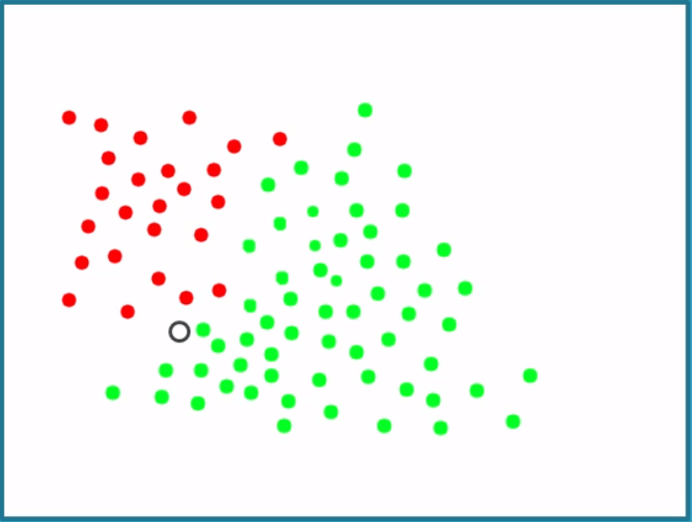
Naïve Bayes Algorithm
Based on Bayes theorem → calculate probability based on previous data, combined with probability from nearby features
Makes naïve assumption that all features are independent
Notes:
For our problem, let's look at three basic algorithms as possibilities for use in our initial training and evaluation. We will look at Naive Bayes, Logistics Regression, and Decision Tree. Each of these algorithms are classic machine learning algorithms, and understanding a little bit about each one can greatly help in understanding more complex algorithms that use these algorithms as building blocks. The Naive Bayes algorithm is based on Bayes' theorem. This theorem calculates a probability of a diabetes by looking at the likelihood of diabetes based on previous data combined with the probability of diabetes on nearby feature values. In other words, so how often does the person having high blood pressure correlate to diabetes? It makes the naive assumption that all of the features we pass in our independent of each other and equally impact the result. For our data, this means that blood pressure is as important as BMI, which is also as important as the number of pregnancies. This assumption that every feature is independent to the others allows for fast conversions and therefore requires a small amount of data to train. The Logistics Regression algorithm has a somewhat confusing name. In statistics, regression often implies continuous values. But Logistics Regression returns a binary result. The algorithm measures the relationship of each feature and weights them based on their impact on the result. The resultant value is mapped against a curve with two values, one and zero, which is equivalent to diabetes or no diabetes in our case. The Decision Tree algorithm can be nicely visualized. The algorithm uses a binary tree structure with each node making a decision based upon the values of the feature. At each node, the feature value causes us to go down one path or another. A lot of data may be required to find the value which defines taking one path or another. As we see, decision trees have the advantage of having tools available to produce a picture of the tree. This makes it easy to follow along and visualize how the trained model works. From these three, let's select Naive Bayes as the initial algorithm for training and evaluation. Naive Bayes has a number of characteristics that make it useful as an initial algorithm. First, it is simple to understand. It uses how often a feature is associated with a result to determine if the value is diabetes or not diabetes. Second, the algorithm is fast. Training time of some of the more complex algorithms can run 100 times or more longer. In a machine learning, you often have repeated cycles of running the algorithm, evaluating the result, and tweaking the data. Having a fast algorithm makes these cycles much quicker. Finally, the algorithm is stable. With some algorithms, as you work with the data, small changes in training parameters cause the results to vary widely. Or worse, the algorithm fails and returns nonsensical results. Both of these can send you on a long and frustrating debugging cycle. Naive Bayes does not exhibit these behaviors. So let's summarize our algorithm selection process. First, we need to acknowledge that there are a lot of algorithms available and more being created every day. With all these algorithms available, we need to select one we will initially train with our data into a model. To select this algorithm, we can use the features of our problem that we captured when we defined our solution statement. From the solution statement, we know we have a supervised machine learning problem, which removes all of the unsupervised machine learning algorithms. We wanted binary results, not continuous values, which further reduces the number of viable algorithms. Since this is initial algorithm training and evaluation, we also eliminated all ensemble algorithms that combine multiple algorithms. We also decided that for initial training, we only wanted basic versions of the algorithms. After evaluating the basic algorithms, we selected Naive Bayes as our initial algorithm, because it is fast, simple, and stable. In the next sections, we will train this algorithm and see how well it can predict if a person is likely to develop diabetes.

Slide 12
Training the Model
Training Data
Algorithm
Prepared Data
Test Data
Notes:
Our plan now is to separate our data into training data and testing data
A good number to split is approximately 70% training and 30% testing
Remember, it is a specific prediction model we are creating, so this model changes based on the data we use

Slide 13
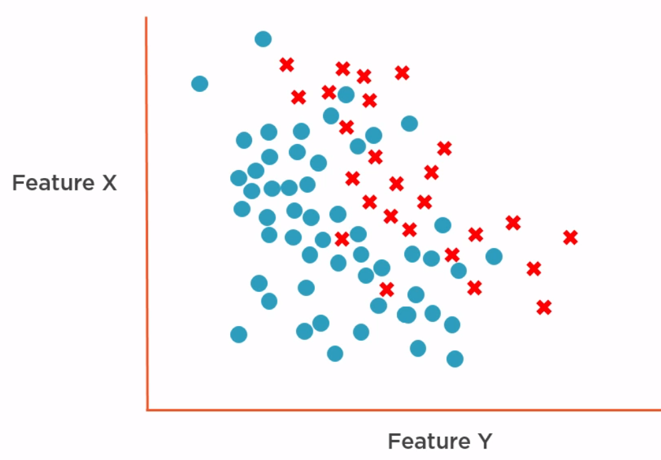
Training the Model
Notes:
So why split the data into two sets? If we use the entire data set to train the model, the additional data would impact the results of the algorithm.
Sure, you have more data to train the model, which is always a good thing, but then you have no data left to verify the model. You can, of course, use the data you had used to train to test as well, but it would falsely perform well.
So splitting the data to two sets essentially “mimics” possible real world data. Mimic in quotes because it is actually real world data
Normally have to choose features to test, but in this case, not too many features, and all are valid
After using the algorithm to analyze the data, the results could be something like the graph
Feature X and Feature Y, and not disease as blue circles, and disease as red

Slide 14
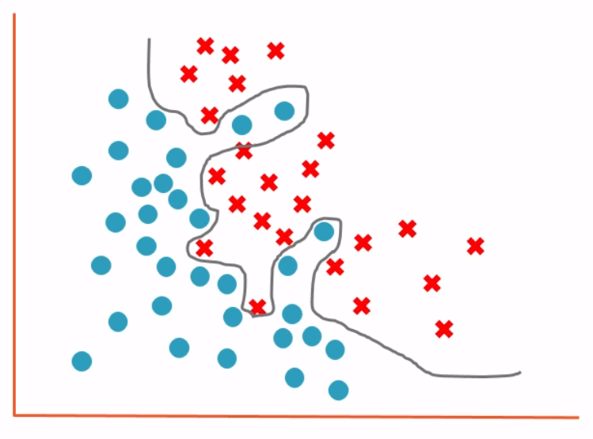
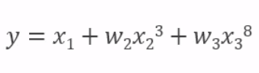
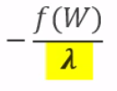
Overfitting
Regularization Hyperparameter
Cross Validation
Bias – variance trade-off
Notes:
the model equation that is produced could be something like the equation shown
this decides a very precise definition around the positive and negative values
but as a result, it produces a model that is very good on the training data, but performs poorly on data it has never seen before
to account for overfitting, we can use hyperparameters.
Specifically, for fixing overfitting, the term is called regularization hyperparameter
Different settings for lambda will essentially determine how much values determined from the training data will be damped by the regularization hyperparameter
Training data will lose accuracy, but will potentially increase accuracy on new data
Experimentation is required to get the best hyperparameter
Cross validation is where we use multiple subsets of training data in training process. Using both can potentially increase accuracy of model
Essentially now we are trying to get a good equalization of both accuracy on training and test data, and this is called bias-variance tradeoff.
Maybe we need to go back to simpler, instead of ensemble, so let’s try logistic regression.

Slide 15
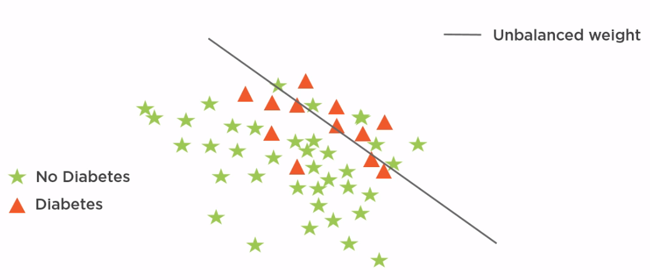
Fixing Unbalanced Classes
Notes:
Hyperparameter will help to fix the class unbalance, potentially leading to better predictive capabilities from the model

Slide 16
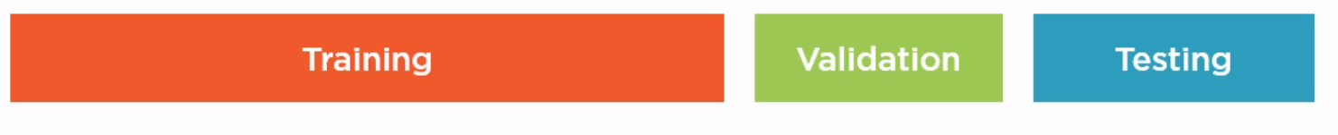
Validation – Test Split
Notes:
Achieved over 70% accuracy, but we cheated by iterating over the training data to find the right value.
Cross validation can do that just that
Breaking it down, we have basically achieved our goal, but we might be doing so only because it works with this specific training/test data set split. We might be influenced by the results with the test data set in this case. How can we evaluate training without using testing data?
One option is to split our data set into three subsets: training, validation, testing. Use validation for tuning, and use testing for only final test.
Issue with this is how do we choose validation set? What if we don’t have enough data, like us.
A better alternative is cross validation.

Slide 17
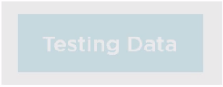
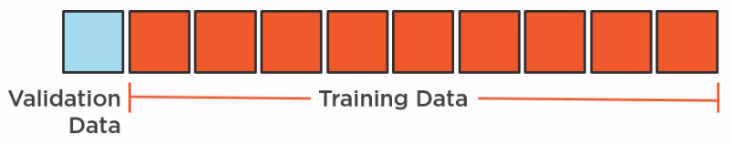
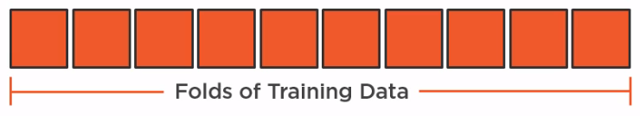
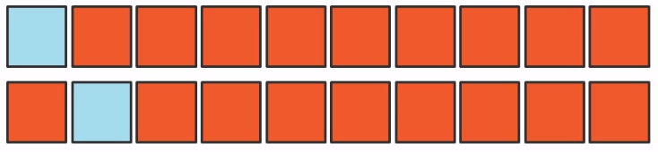
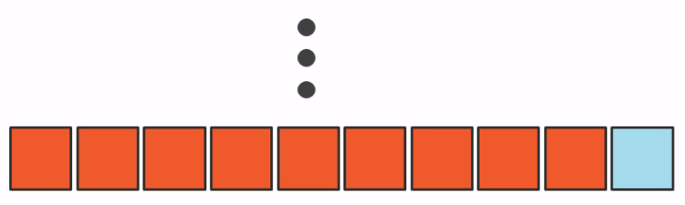
K-fold Cross Validation
Notes:
Do not use testing data for tuning.
Split training data in n folds, each of same size. Then select one fold to be validation set, and all other folds the training set.
Repeat this with the second fold as validation set.
This way, multiple hyperparameters are determined, and each are used in the result of the best value.
Sci-kit learn has a cross validation method, which makes it easy for us
But even easier, it has an ensemble algorithm that does k-fold cross validation, and sets the hyperparameter to the desired value.
The algorithm classes with cross validation simply have CV appended to the class name.

Slide 18
Summary
Asking the right question
Preparing the data
Selecting the algorithm
Training the model
Testing the model
UCI Machine Learning Repository: archive.ics.uci.edu/ml
Notes:
Remember the workflow
R is also a very popular language with machine learning, and very similar to Matlab in its coding style.
Machine learning repository

Slide 19


